Slide 1
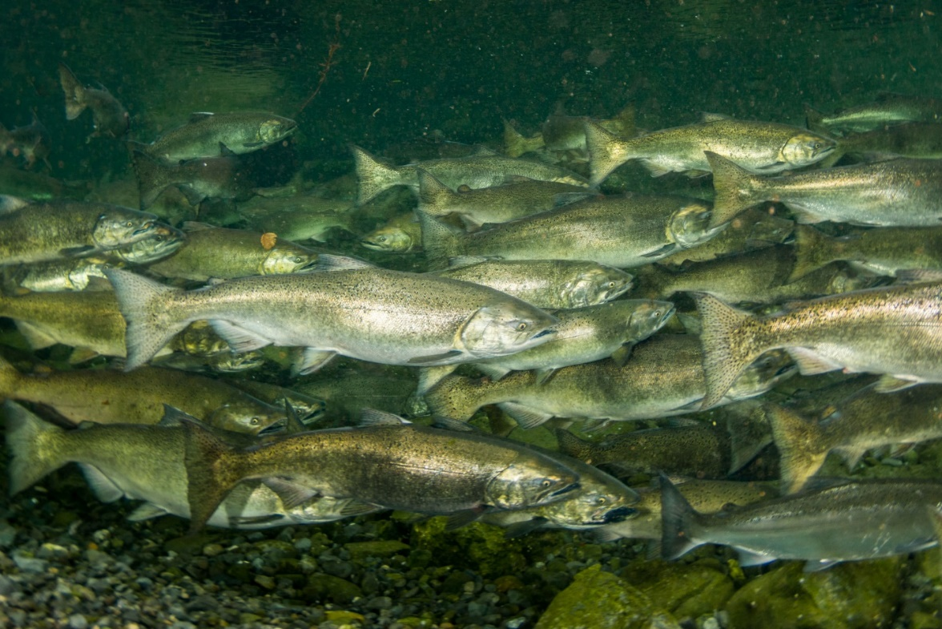
Willamette Fish Facility Design Work Group Minto Fish Facility Juvenile Fish Release Pipe
Chris Walker
Portland District
07 April 2020

Slide 2
Outline
Problem Statement
Operational solution (current)
Structural solution (fish release pipe extenstion)
Discussion (pros and cons)
Data Needs/Next Steps

Slide 3
Problem Statement
Poor hydraulics potentially exist for release of spring Chinook salmon (and summer steelhead) at Minto Fish Facility during spring.
Notes:
Excluded fish facilities (mostly), costs for fish health and marking/tagging not accounted

Slide 4
Video (~7,000 cfs)
[insert video]
Notes:
Excluded fish facilities (mostly), costs for fish health and marking/tagging not accounted

Slide 5
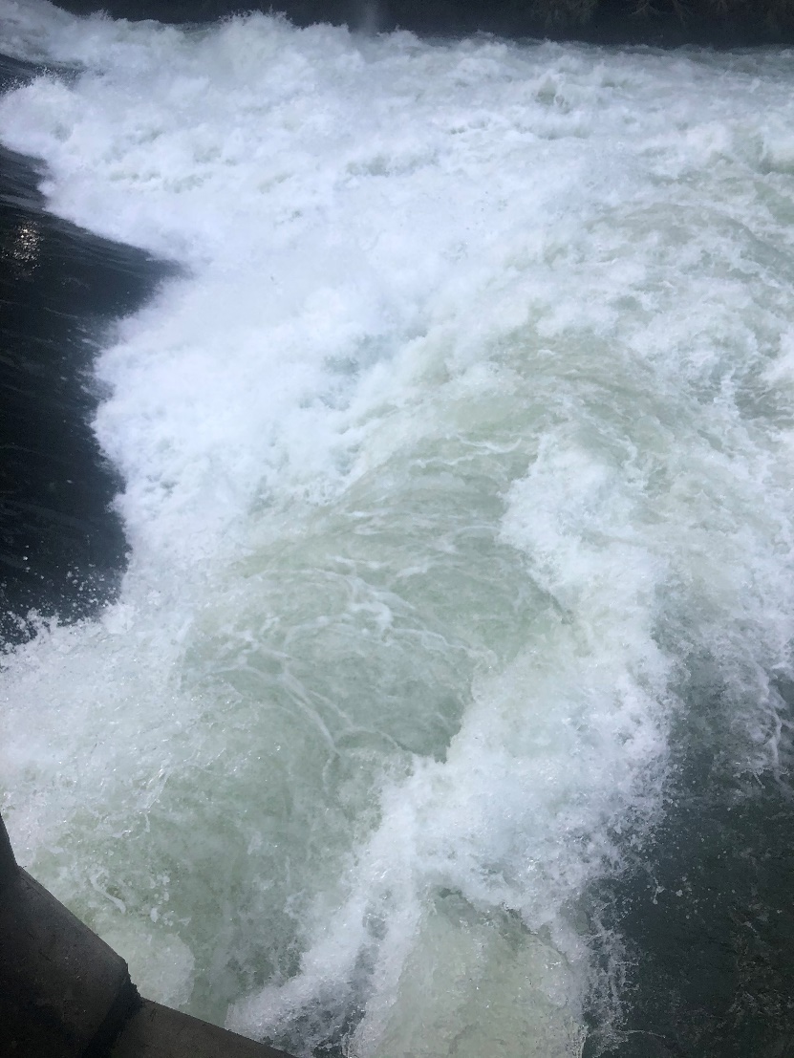
Operational Solution (Current)
Flows: 1,000-1,800 cfs (followed by higher flows)
Water Management coordination
Current hydrologic may constrain operation (e.g. above rule curve)
Able to implement most of the time (timing of fish release can still be impacted)

Slide 6
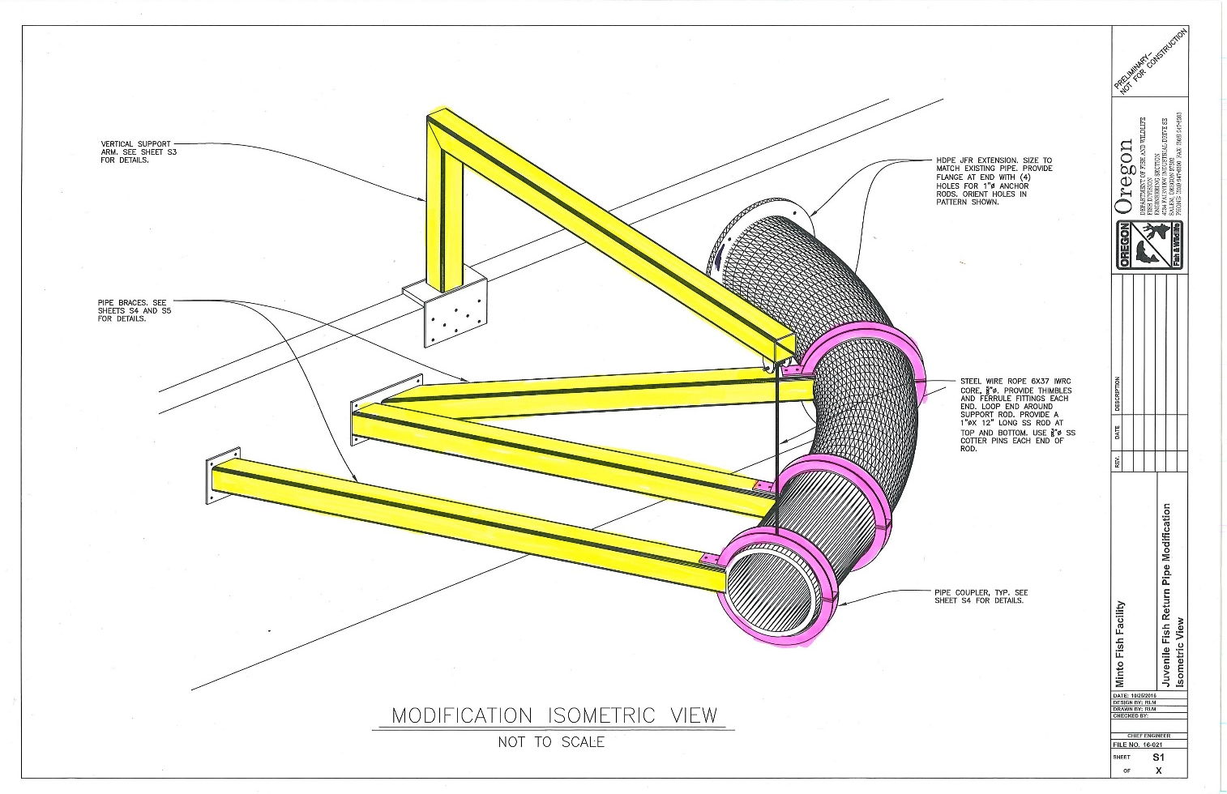
Structural (Juvenile Fish Release Pipe)
Pipe constructed by ODFW (NMFS criteria)
Installed as permanent fixture (although can be removed)
Extends existing pipe into better hydraulics (potentially)
Could allow fish release despite flow conditions (high or low)

Slide 7
Discussion
Operational constraints
Reviews for release pipe (engineering, NMFS)

Slide 8
Data Needs/Next STeps
Hydraulics/other?
Reviews (USACE Engineering/WVP, NMFS, others)
Recommendations (task group?)

Slide 9
Additional Pictures

